Slide 1
Lecture # 5
2nd semester 2013-2014
Dr. Abdulhussein M. Abdullah
Computer Science Dept., College of Science, Basrah University

Slide 2
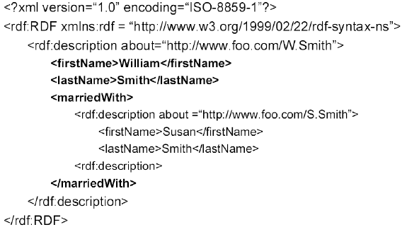
Another Example

Slide 3
Simple Example
<?xml version="1.0"?>
<RDF>
<Description about="http://www.w3schools.com/default.asp">
<author>Jan Egil Refsnes</author>
<created>November 1, 1999</created>
<modified>February 1, 2004</modified>
</Description>
</RDF>

Slide 4
Example Explained
In the example:
–the URI http://www.w3schools.com/-default.asp is used to identify a web page,
–the property "author“ describes the author of the page,
–the property value is "JanEgilRefsnes".
–The property "created“ tells when the page was created, and the property "modified“ when it was last modified.

Slide 5
Subject, Predicate & Object
•RDF terminology also use the words subject, predicate and object.
•The resource http://www.w3schools.com/default.asp is the subject
•The property "author" is the predicate
•The value "Jan Egil Refsnes" is the object

Slide 6
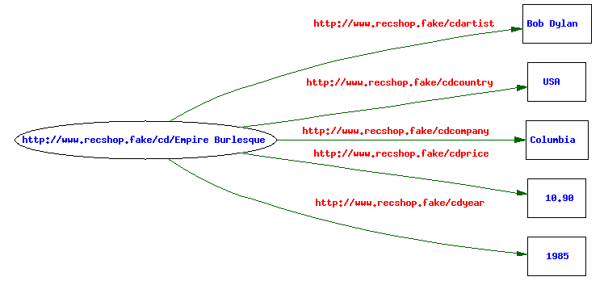
RDF Important Concepts
•Data is represented in RDF as a directed labeled graph.
•An RDF graph is a set of triples, of the form <Subject, Predicate, Object>
Each Subject and each Predicate must be a URI; that is, it has to be a unique identifier, not a literal. An Object can be either a URI or a literal.

Slide 7
Example 2
The first line in the XML file is the XML declaration, telling the version of XML.
<?xml version="1.0"?>
<rdf:RDF>
xmlns:rdf="http://www.w3.org/1999/02/22-rdf-syntax ns#"
xmlns:cd="http://www.recshop.fake/cd" >
<rdf:Description
rdf:about="http://www.recshop.fake/cd/Empire Burlesque">
<cd:artist> Bob Dylan </cd:artist>
<cd:country> USA </cd:country>
<cd:company> Columbia </cd:company>
<cd:price> 10.90 </cd:price>
<cd:year> 1985 </cd:year>
</rdf:Description>
<rdf:Description
rdf:about="http://www.recshop.fake/cd/Hide your heart">
<cd:artist> Bonnie Tyler </cd:artist>
<cd:country> UK </cd:country>
<cd:company> CBS Records </cd:company>
<cd:price> 9.90 </cd:price>
<cd:year> 1988 </cd:year>
</rdf:Description>
</rdf:RDF>

Slide 8
Example 2
The rdf:RDF element indicates that the content is RDF.
<?xml version="1.0"?>
<rdf:RDF>
xmlns:rdf="http://www.w3.org/1999/02/22-rdf-syntax ns#"
xmlns:cd="http://www.recshop.fake/cd" >
<rdf:Description
rdf:about="http://www.recshop.fake/cd/Empire Burlesque">
<cd:artist> Bob Dylan </cd:artist>
<cd:country> USA </cd:country>
<cd:company> Columbia </cd:company>
<cd:price> 10.90 </cd:price>
<cd:year> 1985 </cd:year>
</rdf:Description>
<rdf:Description
rdf:about="http://www.recshop.fake/cd/Hide your heart">
<cd:artist> Bonnie Tyler </cd:artist>
<cd:country> UK </cd:country>
<cd:company> CBS Records </cd:company>
<cd:price> 9.90 </cd:price>
<cd:year> 1988 </cd:year>
</rdf:Description>
</rdf:RDF>

Slide 9
Example 2
The xmlns:rdfnamespace, specifies that tags with the rdf: prefix are from the namespace defined by "http://www.w3.org/1999/02/22-rdf-syntax-ns#".
<?xml version="1.0"?>
<rdf:RDF>
xmlns:rdf="http://www.w3.org/1999/02/22-rdf-syntax ns#"
xmlns:cd="http://www.recshop.fake/cd" >
<rdf:Description
rdf:about="http://www.recshop.fake/cd/Empire Burlesque">
<cd:artist> Bob Dylan </cd:artist>
<cd:country> USA </cd:country>
<cd:company> Columbia </cd:company>
<cd:price> 10.90 </cd:price>
<cd:year> 1985 </cd:year>
</rdf:Description>
<rdf:Description
rdf:about="http://www.recshop.fake/cd/Hide your heart">
<cd:artist> Bonnie Tyler </cd:artist>
<cd:country> UK </cd:country>
<cd:company> CBS Records </cd:company>
<cd:price> 9.90 </cd:price>
<cd:year> 1988 </cd:year>
</rdf:Description>
</rdf:RDF>

Slide 10
Example 2
The xmlns:cdnamespace, specifies that tags with the cd: prefix are from the namespace defined by "http://www.recshop.fake/cd".
<?xml version="1.0"?>
<rdf:RDF>
xmlns:rdf="http://www.w3.org/1999/02/22-rdf-syntax ns#"
xmlns:cd="http://www.recshop.fake/cd" >
<rdf:Description
rdf:about="http://www.recshop.fake/cd/Empire Burlesque">
<cd:artist> Bob Dylan </cd:artist>
<cd:country> USA </cd:country>
<cd:company> Columbia </cd:company>
<cd:price> 10.90 </cd:price>
<cd:year> 1985 </cd:year>
</rdf:Description>
<rdf:Description
rdf:about="http://www.recshop.fake/cd/Hide your heart">
<cd:artist> Bonnie Tyler </cd:artist>
<cd:country> UK </cd:country>
<cd:company> CBS Records </cd:company>
<cd:price> 9.90 </cd:price>
<cd:year> 1988 </cd:year>
</rdf:Description>
</rdf:RDF>

Slide 11
Example 2
The rdf:Description element contains the description of a resource identified by the rdf:about attribute.
<?xml version="1.0"?>
<rdf:RDF>
xmlns:rdf="http://www.w3.org/1999/02/22-rdf-syntax ns#"
xmlns:cd="http://www.recshop.fake/cd" >
<rdf:Description
rdf:about="http://www.recshop.fake/cd/Empire Burlesque">
<cd:artist> Bob Dylan </cd:artist>
<cd:country> USA </cd:country>
<cd:company> Columbia </cd:company>
<cd:price> 10.90 </cd:price>
<cd:year> 1985 </cd:year>
</rdf:Description>
<rdf:Description
rdf:about="http://www.recshop.fake/cd/Hide your heart">
<cd:artist> Bonnie Tyler </cd:artist>
<cd:country> UK </cd:country>
<cd:company> CBS Records </cd:company>
<cd:price> 9.90 </cd:price>
<cd:year> 1988 </cd:year>
</rdf:Description>
</rdf:RDF>

Slide 12
Example 2
The cd:artist element describes a property of the resource, and so does cd:country, etc.
<?xml version="1.0"?>
<rdf:RDF>
xmlns:rdf="http://www.w3.org/1999/02/22-rdf-syntax ns#"
xmlns:cd="http://www.recshop.fake/cd" >
<rdf:Description
rdf:about="http://www.recshop.fake/cd/Empire Burlesque">
<cd:artist> Bob Dylan </cd:artist>
<cd:country> USA </cd:country>
<cd:company> Columbia </cd:company>
<cd:price> 10.90 </cd:price>
<cd:year> 1985 </cd:year>
</rdf:Description>
<rdf:Description
rdf:about="http://www.recshop.fake/cd/Hide your heart">
<cd:artist> Bonnie Tyler </cd:artist>
<cd:country> UK </cd:country>
<cd:company> CBS Records </cd:company>
<cd:price> 9.90 </cd:price>
<cd:year> 1988 </cd:year>
</rdf:Description>
</rdf:RDF>

Slide 13
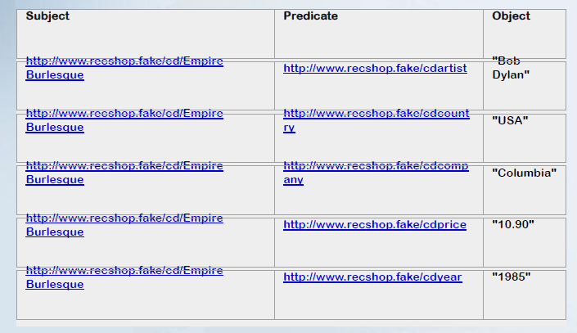
List of Triples (Table Representation)

Slide 14
Main RDF Properties and Attributes
Main RDF Properties
•rdf:subject The subject of the resource in an RDF Statement
•rdf:predicate The predicate of the resource in an RDF Statement
•rdf:object The object of the resource in an RDF Statement
•rdf:type The resource is an instance of a class
Main RDF Attributes
•rdf:RDF The root of an RDF document
•rdf:about Defines the resource being described
•rdf:Description Container for the description of a resource
•rdf:resource Defines a resource to identify a property
•rdf:datatype Defines the data type of an element

Slide 15
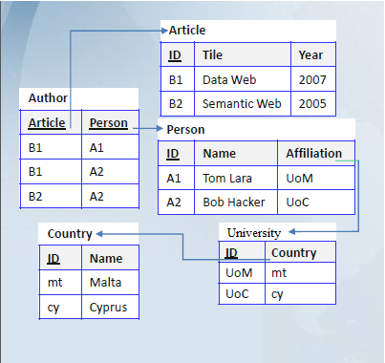
Database into RDF (Example)
S | P | O
:B1 | rdf:Type | :Article
:B1 | :Title | “Data Web”
:B1 | :Year | 2007
:B2 | rdf:Type | :Article
:B2 | :Title | “Semantic Web”
:B2 | :Year | 2005
:B1 | :Author | :A1
:B1 | :Author | :A2
:B2 | :Author | :A2
:A1 | rdf:Type | :Person
:A1 | :Name | “Tom Lara”
:A1 | :Affiliation | :UoM
:A2 | :Type | :Person
:A2 | :Name | “Bob Hacker”
:A2 | :Affiliation | :UoC
:UoM | :Type | :University
:UoM | :Country | :mt
:UoC | :Type | :University
:UoC | :Country | :cy
:mt | :Type | :Country
:mt | :Name | “Malta”
:cy | :Type | :Country
:cy | :Name | “Cyprus”

Slide 16
XML into RDF (Example)

Slide 17
Summary

Slide 18
Semantic Web
a way of linking data between systems or entities that allows for rich, self-describing interrelations of data available across the globe on the web.

Slide 19
How Does It Differ From The Web As It Is Today?

Slide 20
Today,
much of the data in HTML document forms that are linked to each other through the use of hyperlinks
Readable by Human and Machine
Machines
have difficulty extracting any meaning
Seeking Keywords

Slide 21
Semantic Web
publishing data in human readable HTML documents
Semantic Web
machine readable documents.
machines can do a little more of the thinking work

Slide 22
Today Web
contains lots of information, but the raw data itself isn't available
Semantic Web
Databases
machines can use

Slide 23
semantic web seeks to change the scope of the internet with regard this problem in a number of ways:
Opening up the web of data to artificial intelligence processes (getting the web to do a bit of thinking for us).
Encouraging companies, organizations and individuals to publish their data freely, in an open standard format.
Encouraging businesses to use data already available on the web (data give/take).

Slide 24
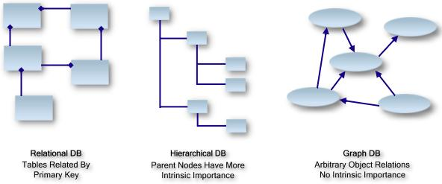
The Graph Database
For example, take an XML document. An XML document typically contains nodes of information each with a parent node. At the root of the document is the highest level node, which has no parent.
For example MySQL, MS SQL
For example XML

Slide 25
The Graph Database
there is no concept of roots (or a hierarchy). A graph consists of resources related to other resources, with no single resource having any particular intrinsic importance over another.
For example MySQL, MS SQL
For example XML

Slide 26
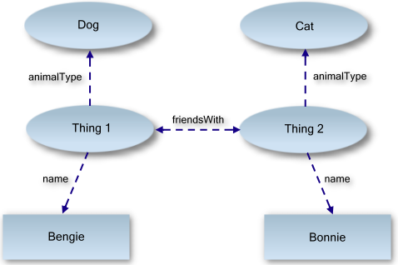
An Example Of A Data Graph
look at a series of statements about how things relate to each other
We can see the properties
name, animalType and friendsWith.
Bengie is a dog. Bonnie is a cat. Bengie and Bonnie are friends.
We can see that our two things
Using these three simple statements, let's turn this into a data graph

Slide 27
Important Point The arrows in the previous diagram are properties, sometimes called predicates.
Remember for now that the terms property and predicate are interchangable, and that it is the arrows that describe the properties in the graph.

Slide 28
RDF
RDF is a common acronym within the semantic web community because it forms one of the basic building blocks for forming the web of semantic data.
What it defines is a type of database which something called a graph database.

Slide 29
RDF statement, or sometimes called an RDF triple is consist of three parts:
subject, predicate, and object.

Slide 30
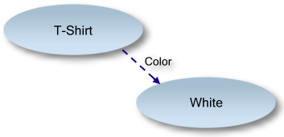
Look at the following graph of data describing the color of a T-shirt:
Subject
Predicate
Object

Slide 31
Important Point:
RDF, whilst the foundation of defining data structures for the semantic web, does not in itself describe the semantics, or meaning, behind the data.

Slide 32
Building An RDF Document
This namespace, and the RDF node, forms the root of all RDF documents.
First, add the RDF root node:
1. <rdf:RDF
2. xmlns:rdf="http://www.w3.org/1999/02/22-rdf-syntax-ns#">
3.
4. <!-- Body Code Omitted -->
5.
6. </rdf:RDF>
the standard W3.org namespace
This namespace tells any machine reader that the enclosing document is an RDF document, and that the rdf:RDF tag resides in this namespace.

Slide 33
The rdf:Description tag simply means "I'm going to describe something (a subject) and I'm giving it the unique ID
Add A Statement
Unique ID
01.<rdf:RDF
02.xmlns:rdf="http://www.w3.org/1999/02/22-rdf-syntax-ns#">
03.
04. <rdf:Description rdf:about="http://www.linkeddatatools.com/clothes#t-shirt">
05.
06. <!-- Statement Code Omitted -->
07.
08. </rdf:Description>
09.
10.</rdf:RDF>

Slide 34
Add Predicates
01.<rdf:RDF
02.xmlns:rdf="http://www.w3.org/1999/02/22-rdf-syntax-ns#"
03.xmlns:feature="http://www.linkeddatatools.com/clothing-features#">
04.
05.<rdf:Description rdf:about="http://www.linkeddatatools.com/clothes#t-shirt">
06.
07. <feature:size> 12 </feature:size>
08.
09.</rdf:Description>
10.
11.</rdf:RDF>
"The subject has a property with name feature:size which has the literal value 12".

Slide 35
On line 03, notice that we've defined the XML namespace feature by giving it the namespace URI http://www.linkeddatatools.com/clothing-features#.
The purpose of this namespace is simply to avoid name conflicts with tags of the same name: other tags with the name "size" could be defined with other namespace URIs, and an RDF reader would still be able to tell that they were different properties even though they had the same tag name.

Slide 36
Note
XML namespace URIs in RDF are used to distinguish between properties with the same (tag) name. To get the fully qualified URI, simply substitute the namespace prefix with the namespace URI.

Slide 37
add one more predicate: the color of the T-shirt
01.<rdf:RDF
02.xmlns:rdf="http://www.w3.org/1999/02/22-rdf-syntax-ns#"
03.xmlns:feature="http://www.linkeddatatools.com/clothing-features#">
04.
05.<rdf:Description rdf:about="http://www.linkeddatatools.com/clothes#t-shirt">
06.
07. <feature:size>12</feature:size>
08. <feature:color rdf:resource="http://www.linkeddatatools.com/colors#white"/>
09.
10.</rdf:Description>
11.
12.</rdf:RDF>
"The subject has a property with name feature:color which has ID".

Slide 38
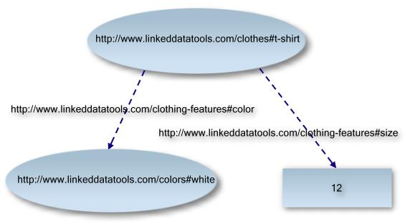
The graph with fully qualified URIs.

Slide 39
Remember
A subject in an RDF document may also be referenced as a object of a property in another RDF statement (in the resource attribute).
This can be a confusing concept for those starting out with RDF.

Slide 40
test your understanding
identify on the RDF document below the:
Subject of the statement
Predicates of the statement - including whether they are resources or literals
Objects referenced by the resource predicates
01.<?xml version="1.0" encoding="UTF-8"?>
02.
03.<rdf:RDF
04.xmlns:rdf="http://www.w3.org/1999/02/22-rdf-syntax-ns#"
05.xmlns:dc="http://purl.org/dc/elements/1.1/"
06.xmlns:region="http://www.country-regions.fake/">
07.
08.<rdf:Description rdf:about="http://en.wikipedia.org/wiki/Oxford">
09.<dc:title>Oxford</dc:title>
10.<dc:coverage>Oxfordshire</dc:coverage>
11.<dc:publisher>Wikipedia</dc:publisher>
12.<region:population>10000</region:population>
13.<region:principaltown rdf:resource="http://www.country-regions.fake/oxford"/>
14.</rdf:Description>
15.
16.</rdf:RDF>

Slide 41
Why Include Semantics In Data? Knowledge Integration
two websites are started independently from each other.
One site hosts information on current and historic Oscar winning films;
the other a large database of biographies of Hollywood actors and actresses.

Slide 42
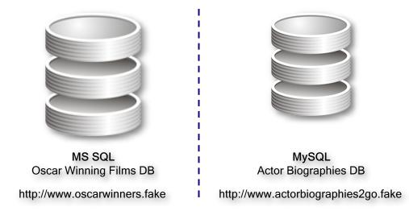
Sharing Without Semantic Modeling
all of the Oscar winning films ever produced and also a list of actors and actresses who starred in them.
However, it doesn't hold any other actor information other than their name and date of birth.

Slide 43
Sharing Without Semantic Modeling
contains a complete listing of many current and former Hollywood actors, including a complete biography, plus a list of movies that they starred in
But, it does not contain any film plots, or screenshots of the films.

Slide 44
Let's look at how these two sites might collaborate
Obviously, the users of http://www.oscarwinners.fake would benefit from being able to click on the name of a starring actor and find out more about them - this information is stored in the MySQL database at http://www.actorbiographies2go.fake.
Likewise, the users of http://www.actorbiographies2go.fake would benefit from being able to click on the names of films that the actors starred in and find more information. This is stored in the MS SQL database at http://www.oscarwinners.fake.

Slide 45
Any sharing of data between the two sites cannot be done by joining tables in their databases. Firstly, they have been independently designed in the first place and so their primary keys referring to individual actors or films in both databases will not be synchronized. They would have to be mapped. But secondly, they are using different database server systems which are not cross-compatible.
To collaborate using their current databases, the owners of either site would have to decide on a common data format by which to share information that they could both understand by using a common film and actor unique ID scheme of their own invention. They could do this, for example, by creating a secure XML endpoint on each of their websites from which they can request information from each other on demand. This way, their shared information is always up to date.

Slide 46
Important Point
This sort of information interchange across incompatible, independently designed data systems takes time, money and human contextual interpretation of the different datasets. It also is restrictive to the data domains of only these two websites, any further additions to their knowledge from elsewhere will demand similar efforts. It requires humans to understand the meaning of the data and agree on common formats to collaborate the two databases appropriately.

Slide 47
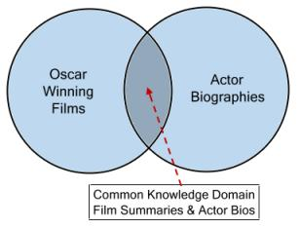
Sharing With The Semantic Web Model
In semantic modeling, the following are important terms you should know:
Vocabulary
A collection of terms given a well-defined meaning that is consistent across contexts.
Ontology
Allows you to define contextual relationships behind a defined vocabulary. It is the cornerstone of defining a knowledge domain.

Slide 48
how do we model the two site scenario using semantic modeling?
1. the two sites need to apply a common, standard vocabulary to describe their data that is contextually consistent.
2. the two sites adopting the same base ontology for expressing the meaning behind the data they expose,

